Slide 1
Graphing special number sequences using technology
Non-linear relationships

Slide 2
how to use Oak lessons

Slide 3
I can plot the graph of a special number sequence.

Slide 4
A triangular number (or triangle number) is a number that can be represented by a pattern of dots arranged into a triangle. The term number is the number of dots in any side of the triangle.
1
3
6
10
15

Slide 5

Graphing special number sequences using technology
Plotting sequences using Desmos
Exploring special number sequences

Slide 6
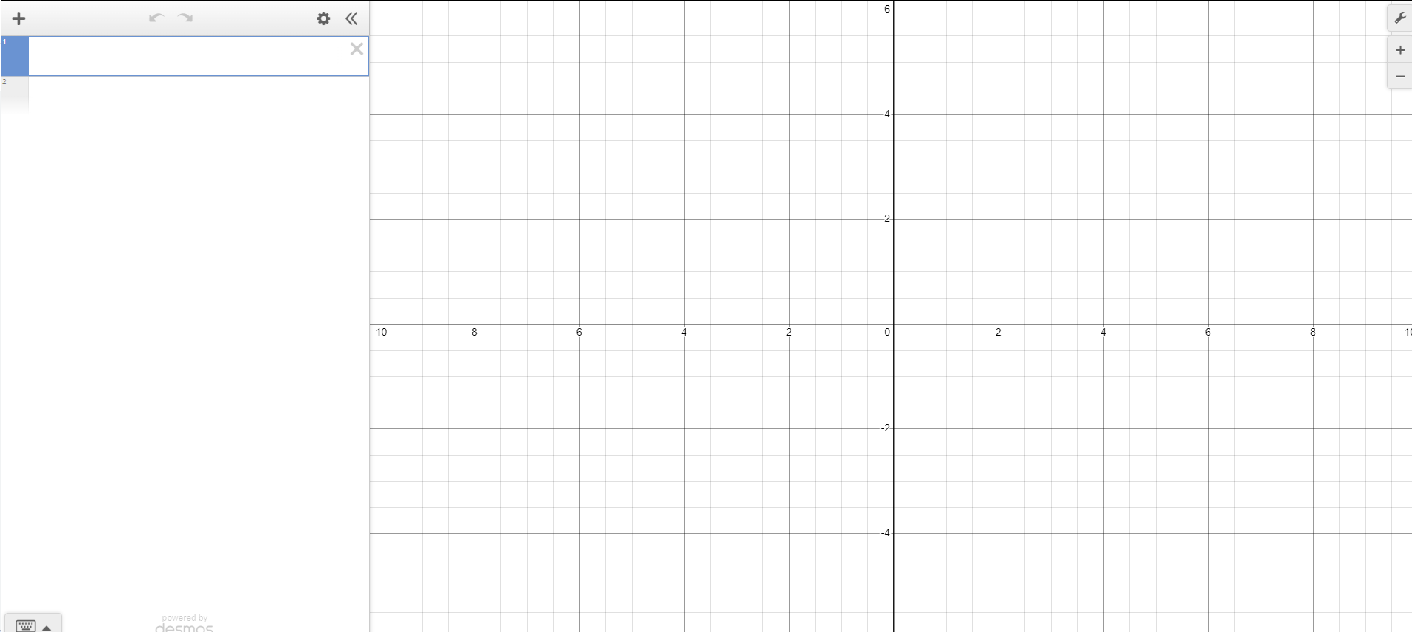
Plotting sequences using Desmos
We can plot sequences on graphs by turning the term numbers and terms into coordinates.
Using graphing software allows us to plot more points quickly and easily.
We are going to look at plotting sequences using technology, to start:
Open up a web browser and go to desmos.com
Find and press the ‘graphing calculator’ button
Your screen should look like this

Slide 7
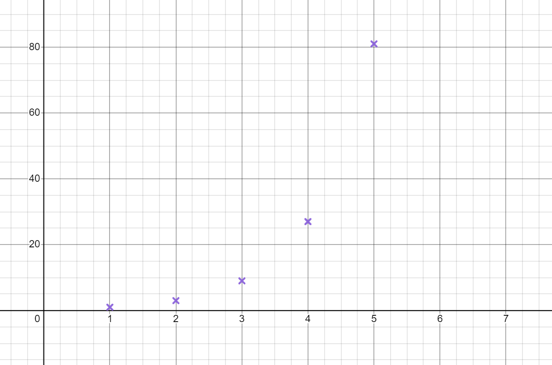


Plotting sequences using Desmos
We are going to start by plotting a geometric sequence.
Start by plotting the first five terms 1, 3, 9, 27, 81, … on Desmos
You can zoom out and stretch the x axis scale to make it look like this.
I think the n^{th} term could be 2n − 1
Jacob
Why is this definitely not true?
2n − 1 would be a linear sequence so points would be on a straight line.

Slide 8
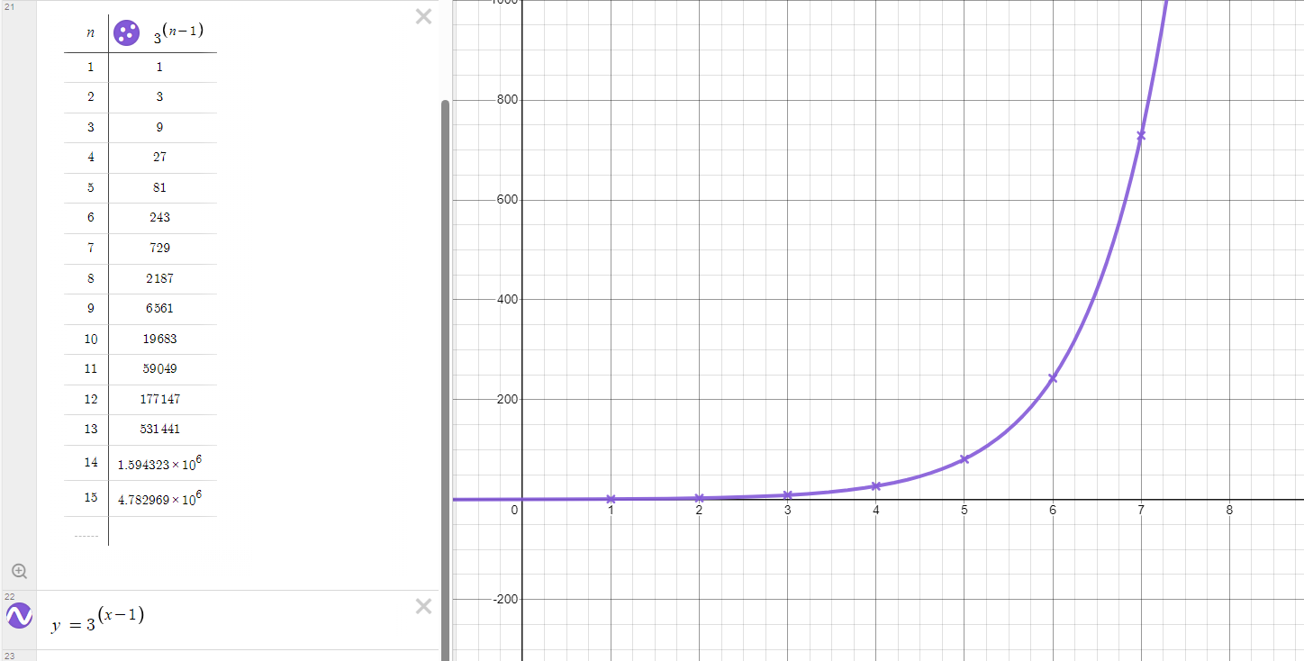
Plotting sequences using Desmos
The n^{th} term rule is 3^{n − 1}
You do not need to be able to work this out yet.
Type a suitable equation into desmos to check this does fit our sequence. You may wish to plot some more points to be sure.
By typing the equation y = 3^{(x − 1)} we can see this does go through the points so 3^{n − 1} is the correct n^{th} term rule

Slide 9
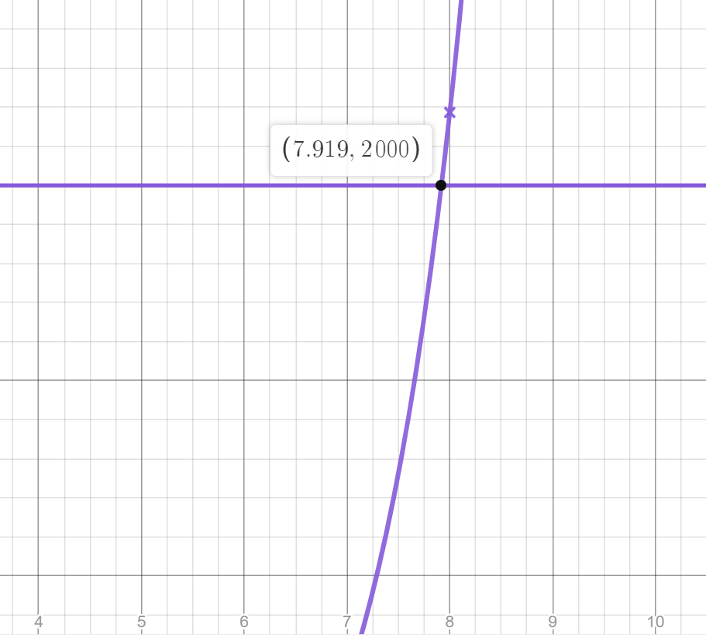
Plotting sequences using Desmos
Drawing the graph of the n^{th} term rule allows us to check if larger term values are in the sequence.
Is the number 2000 in the geometric sequence 1, 3, 9, 27, …. ?
Type the equation y = 2000
Click on the point where this line intersects the curve.
The x value is not an integer so 2000 is not a term in our sequence.
This value is between the 7th and 8th terms

Slide 10
Plotting sequences using Desmos
When plotting a sequence on a graph we do not draw a line or curve through the points.
The term numbers in our sequence are the positive integers greater than or equal to 1.
A line or curve shows all values that fit the rule, including non-integer x values, this does not make sense for a sequence.
However, when using graphing software it can often be useful to draw the line or curve.
Be aware when using this method that terms in the sequence only occur on coordinates with a positive integer x value.

Slide 11
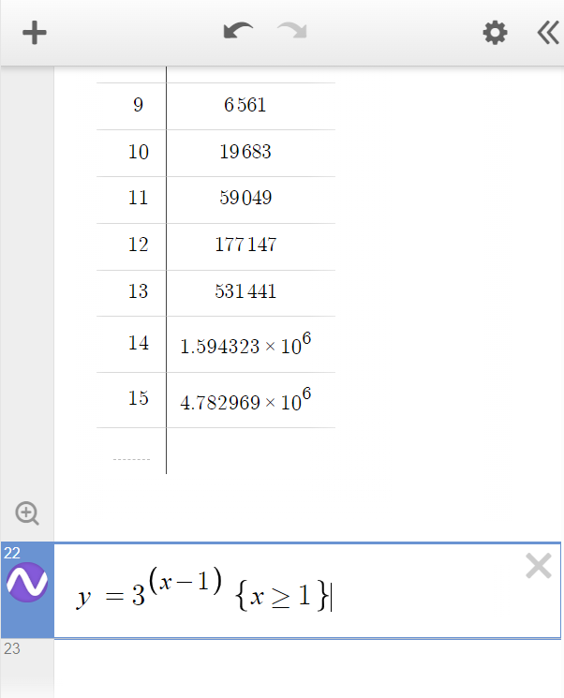
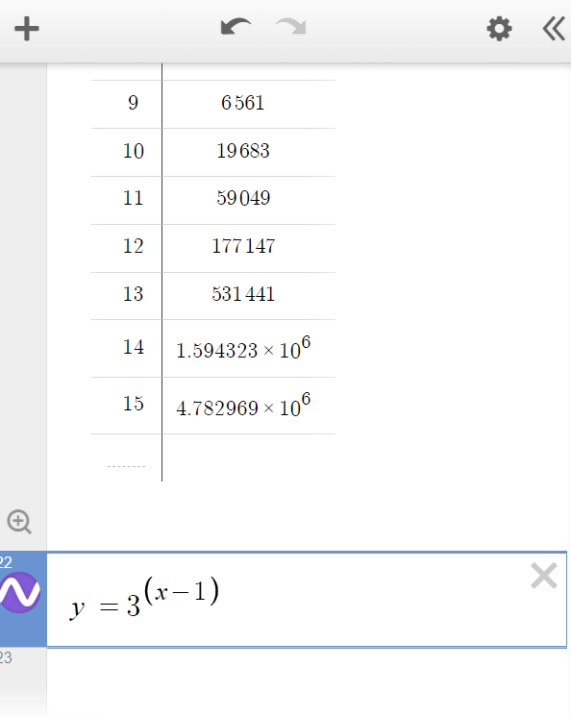
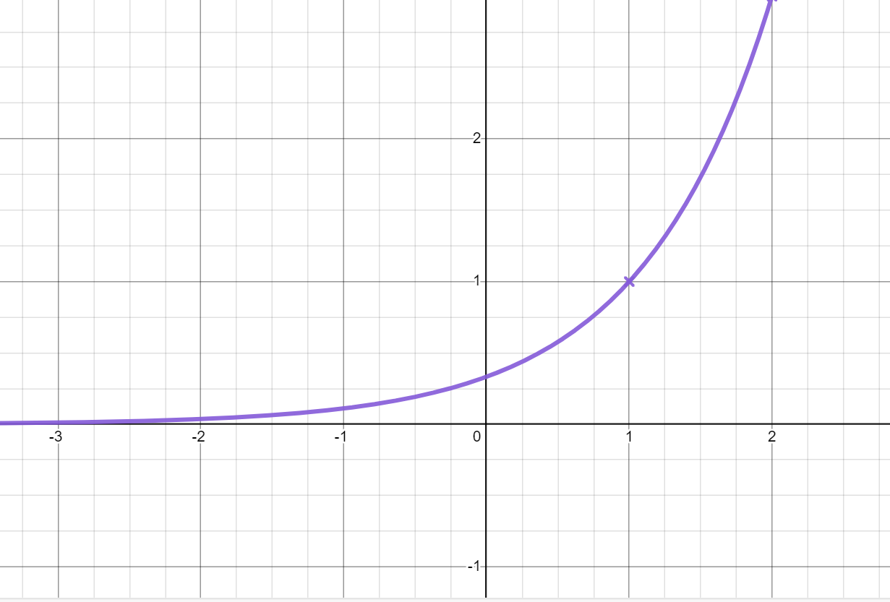
Plotting sequences using Desmos
We can limit the graph so it only displays the part where the term number is 1 or greater.
If this is a sequence, we only need the part of the graph after the coordinate (1,1)
Click on the equation you wish to limit.
Use curly brackets and inequality symbols to limit the inputs.
Try typing {x ≥ 1}
(clicking = after > inputs the ≥ symbol)
What happens to your graph?

Slide 12
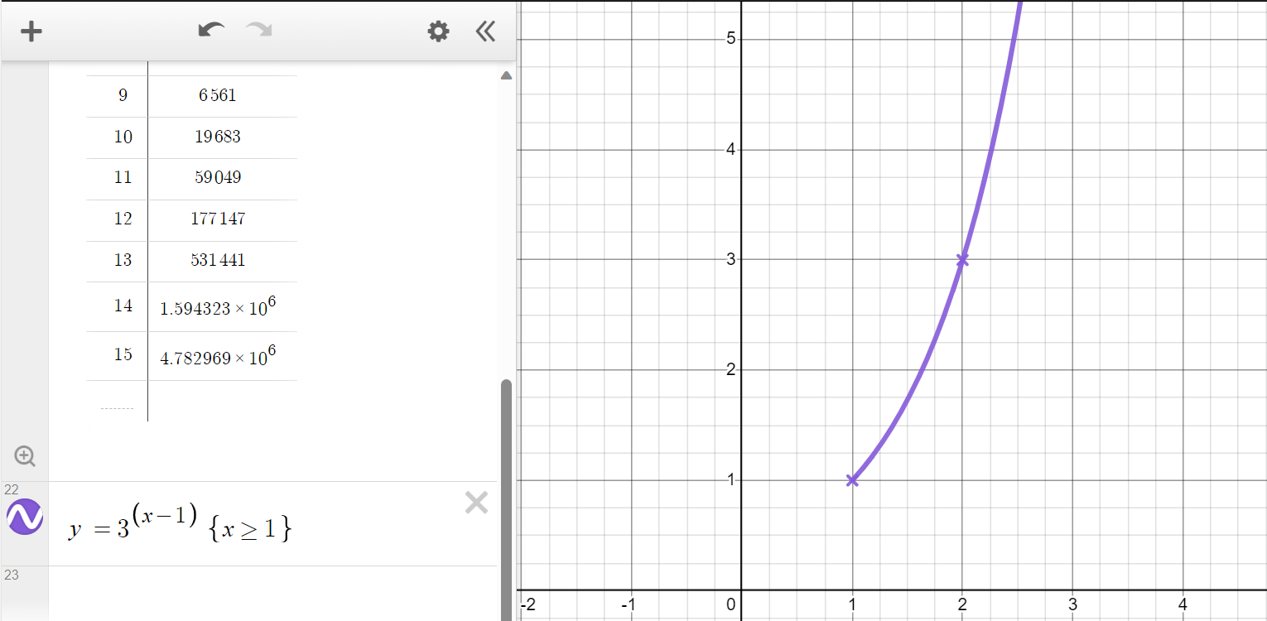
Plotting sequences using Desmos
The graph now only shows the values that fit the rule where x is 1 or greater.
The part of the graph where x is less than 1 has disappeared

Slide 13
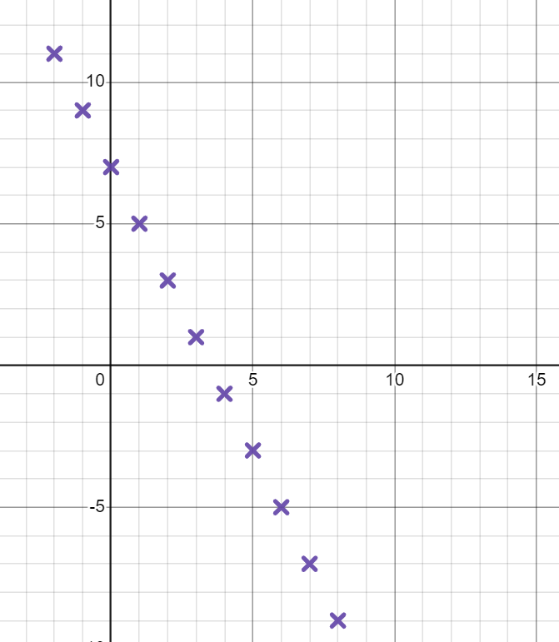
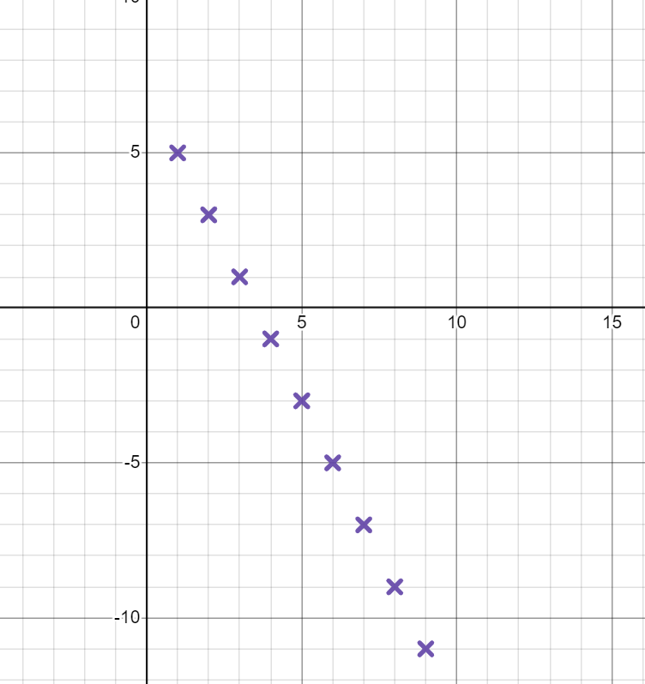
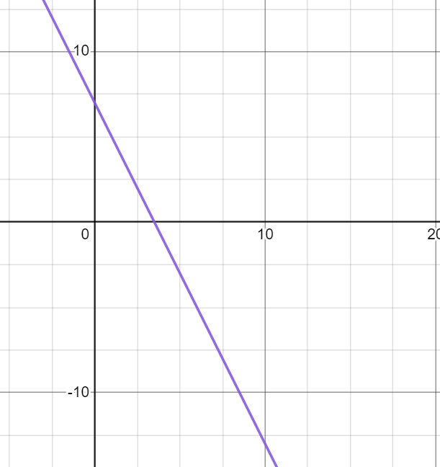
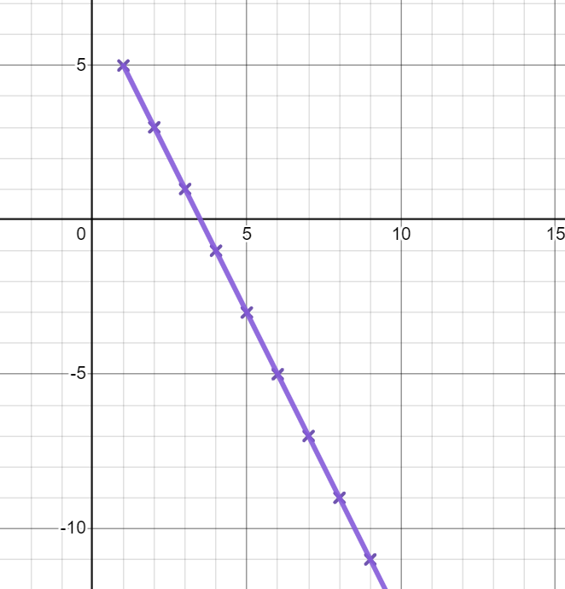


Plotting sequences using Desmos
Which of the following is the correct graph of the sequence 7 − 2n ?
Explain your answer.
When plotting a sequence like this, no line should be drawn. The first term of this sequence is when n = 1 so there should be no coordinates to the left of x = 1
a
b
c
d

Slide 14
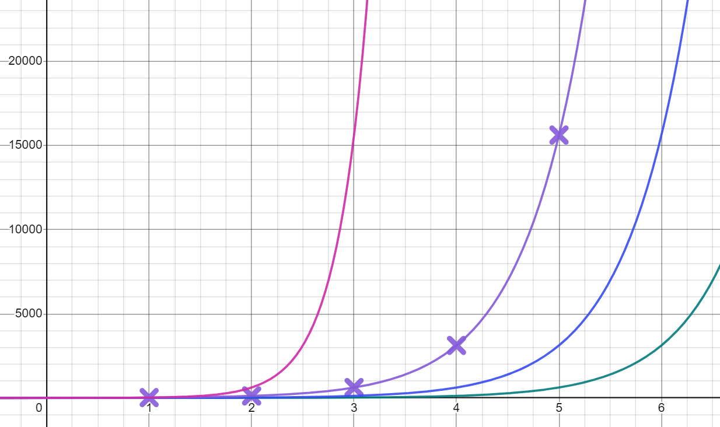
Plotting sequences using Desmos
Use Desmos to determine which of these is the correct n^{th} term rule for the geometric sequence which starts 25, 125, 625, 3125, 15625, …
(Hint- you will need to stretch the scale on your x axis and zoom out)
a
5^{n − 1}
y = 5^{2x}
y = 5^{(x + 1)}
y = 5^{x}
b
5^{n + 1}
c
5^{n}
d
5^{2n}
y = 5^{(x − 1)}

Slide 15
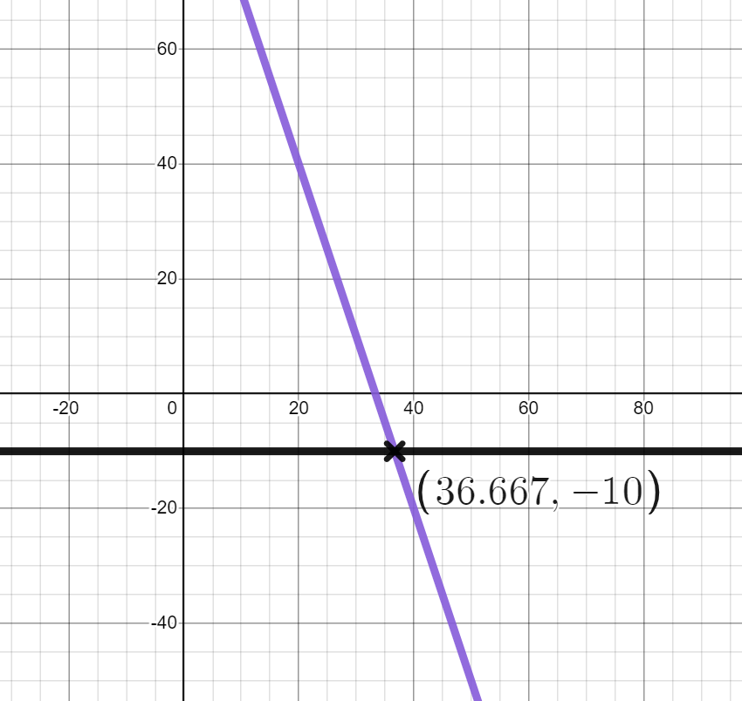

Plotting sequences using Desmos
Lucas wants to know if −10 is in the sequence 100 − 3n
I have plotted the lines y = 100 − 3n and y = −10. They intersect so −10 is a term in the sequence 100 − 3n
a) What has Lucas done correctly?
Lucas
b) Explain to Lucas what mistake he has made.

Slide 16
Plotting sequences using Desmos
2) Use Desmos to match these sequences to their n^{th} term rules
a) Geometric sequence with first five terms: 2, 4, 8, 16, 32, …
4 × 3^{n}
b) Geometric sequence with first five terms: 8, 16, 32, 64, 128, …
3 × 2^{n}
c) Geometric sequence with first five terms: 6, 12, 24, 48, 96, …
2 × 3^{n}
d) Geometric sequence with first five terms: 6, 18, 54, 162, 486, …
2^{n}
e) Geometric sequence with first five terms: 12, 36, 108, 324, 972, …
2^{n + 2}

Slide 17
Plotting sequences using Desmos
3) Use graphing software to help with the following questions.
Term number | 1 | 2 | 3 | 4 | n
Term | −1.5 | 0.6 | 2.7 | 4.8 | 2.1n − 3.6
a) Is the number 30 in this sequence?
Term number | 1 | 2 | 3 | 4 | n
Term | 8 | 24 | 72 | 216 | 8 × 3^{n − 1}
b) Is the number 324 in this sequence?
Term number | 1 | 2 | 3 | 4 | n
Term | 10 | 20 | 40 | 80 | 5 × 2^{n}
c) Is the number 1280 in this sequence?
Term number | 1 | 2 | 3 | 4 | n
Term | 4 | 16 | 64 | 256 | 4^{n}
d) Is the number 4004 in this sequence?

Slide 18
Plotting sequences using Desmos
Lucas wants to know if −10 is in the sequence 100 − 3n
I have plotted the lines y = 100 − 3n and y = −10. They intersect so −10 is a term in the sequence 100 − 3n
a) What has Lucas done correctly?
He has plotted the correct lines and looked for the intersection point.
Lucas
b) Explain to Lucas what mistake he has made.
To be in the sequence, the x coordinate has to be an integer. This coordinate shows −10 is between the 36th and 37th term but is not in the sequence.

Slide 19
Plotting sequences using Desmos
2) Use Desmos to match these sequences to their n^{th} term rules
a) Geometric sequence with first five terms: 2, 4, 8, 16, 32, …
4 × 3^{n}
b) Geometric sequence with first five terms: 8, 16, 32, 64, 128, …
3 × 2^{n}
c) Geometric sequence with first five terms: 6, 12, 24, 48, 96, …
2 × 3^{n}
d) Geometric sequence with first five terms: 6, 18, 54, 162, 486, …
2^{n}
e) Geometric sequence with first five terms: 12, 36, 108, 324, 972, …
2^{n + 2}

Slide 20
Plotting sequences using Desmos
3) Use graphing software to help with the following questions.
Term number | 1 | 2 | 3 | 4 | n
Term | −1.5 | 0.6 | 2.7 | 4.8 | 2.1n − 3.6
a) Is the number 30 in this sequence?
Yes the 16th term
Term number | 1 | 2 | 3 | 4 | n
Term | 8 | 24 | 72 | 216 | 8 × 3^{n − 1}
b) Is the number 2044 in this sequence?
No between the 6th and 7th term
Term number | 1 | 2 | 3 | 4 | n
Term | 10 | 20 | 40 | 80 | 5 × 2^{n}
c) Is the number 1280 in this sequence?
Yes the 8th term
Term number | 1 | 2 | 3 | 4 | n
Term | 4 | 16 | 64 | 256 | 4^{n}
d) Is the number 4004 in this sequence?
No between the 5th and 6th term

Slide 21
Graphing special number sequences using technology
Plotting sequences using Desmos
Exploring special number sequences

Slide 22

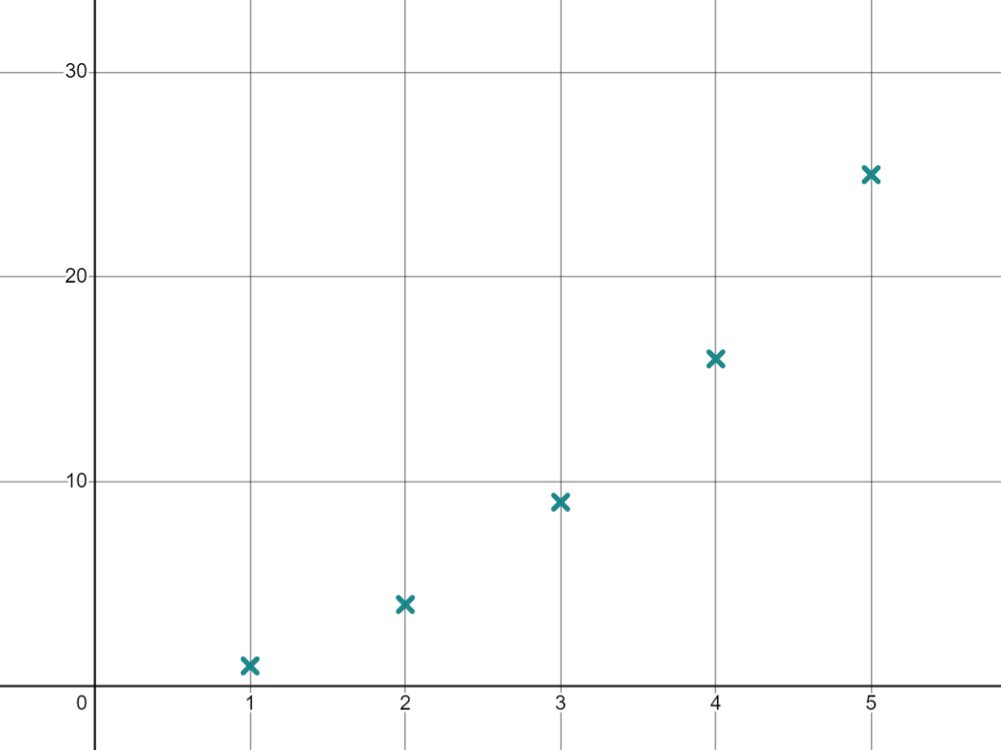
Exploring special number sequences
I wonder what the square numbers look like when plotted on a graph
We can build a sequences out of square numbers.
What are the first five square numbers?
1, 4, 9, 16, 25, …
Jun
Use the table function to plot these points.
You can stretch the x axis to get a better idea of the shape of the graph.
This is the beginning of the sequence of all square numbers in ascending order.

Slide 23
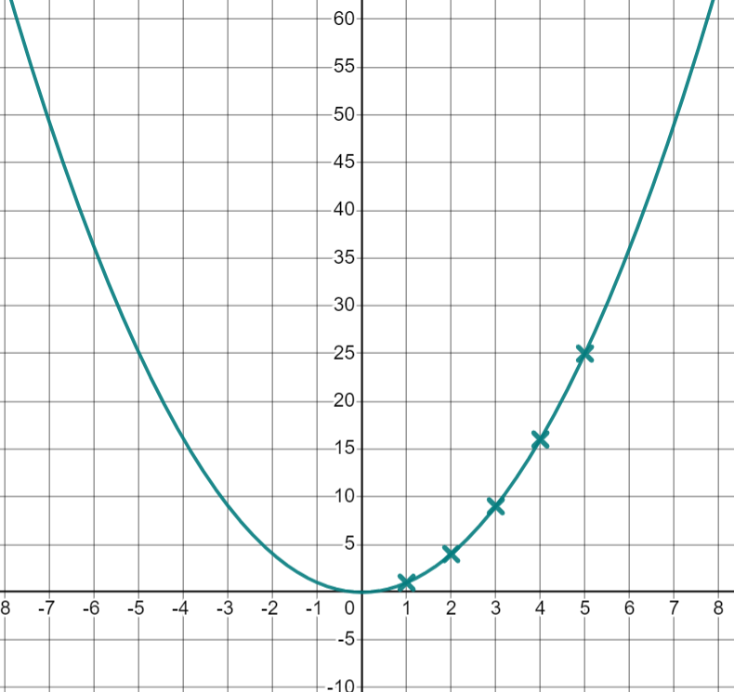
Exploring special number sequences
How is this sequence generated? What would the n^{th} term be?
This sequence is generated by squaring the term number. The n^{th} term is n².
Jun uses the n^{th} term to draw this graph
That’s interesting, it makes a sort of ‘U’ shape.
Jun
Jun’s comment applies to the graph of y = x² What does he need to remember about the sequence n² ?

Slide 24
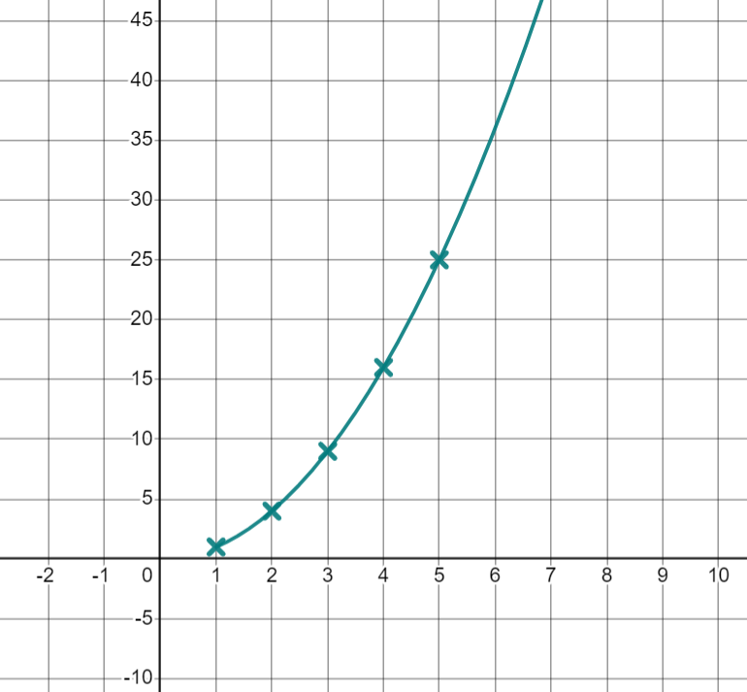

Exploring special number sequences
Jun’s comment applies to the graph of y = x² What does he need to remember about the sequence n² ?
This sequence starts when n = 1 so the part of the graph to the left of x = 1 is not part of the sequence.
Try using curly brackets so the graph no longer shows values when x is less than 1
What do you think the sequence of all cube numbers in ascending order will look like when plotted? Make a prediction.

Slide 25
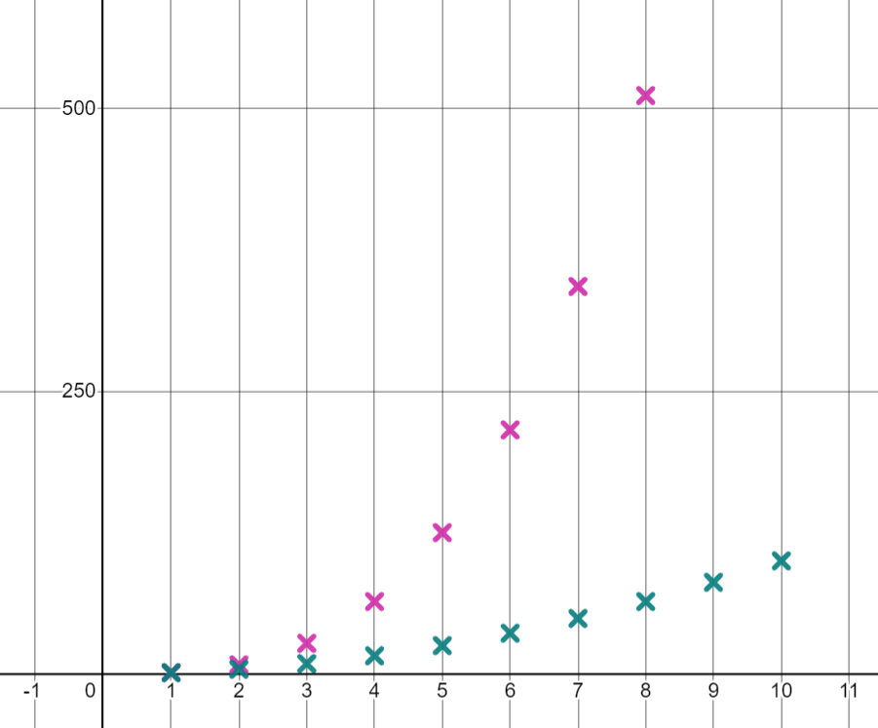


Exploring special number sequences
The sequence of all cube numbers in ascending order is generated by cubing the term number, the n^{th} term is therefore n³ ?
Use the n^{th} term to generate the first 10 terms of the sequence n³ on a graph.
This sequence also produces a curve, it increases at a faster rate than n²
I think the number 1 is in both sequences
Jacob
Is Jacob correct? How do you know?

Slide 26
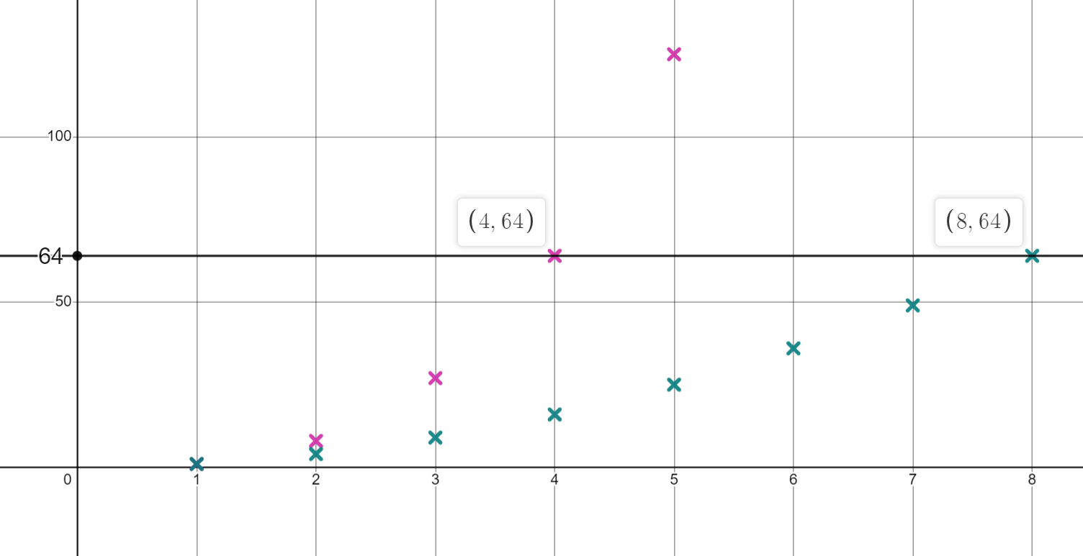
Exploring special number sequences
You may have said:
Both sequences have the coordinate (1,1) on their graphs. They both have a first term of 1
There are other terms which are in both sequences just not in the same position in the sequence.
By zooming in, we can see that 64 is the 4th term in the sequence n³ and the 8th term in the sequence n²
Numbers in both sequences will be on the same horizontal line.

Slide 27

Exploring special number sequences
What do you think the sequence of all triangular numbers will look like when plotted?
I think they will make a curve again
I think they will start in the same place as the square and cube numbers.
Jacob
Lucas
I think they will be between the square and cube numbers
Which of these statements do you agree with? Use these ideas to make your prediction.
Jun

Slide 28
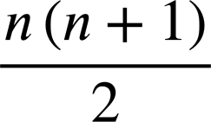
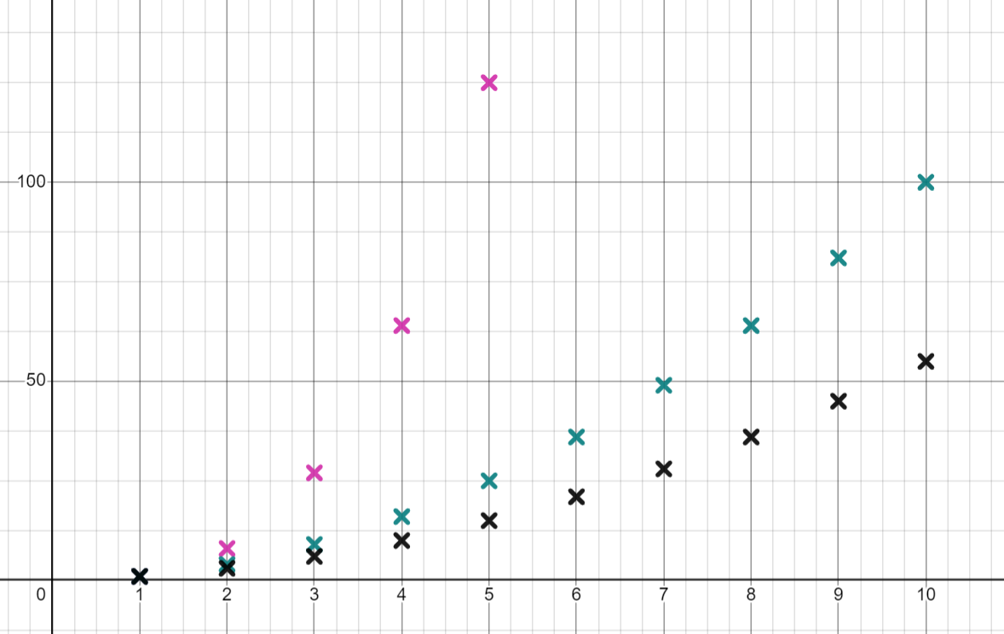
Exploring special number sequences
The n^{th} term for the triangular numbers can be written as
Use this to generate the first 10 terms in this sequence. Does it look as you predicted?
They form another curve starting at (1,1) this curve increases at a slower rate.
Can you find a number which is in the sequence of square numbers and the sequence of triangular numbers?
36
36 is the 6th square number and 8th triangular number. 1 is the 1st term in both sequences

Slide 29
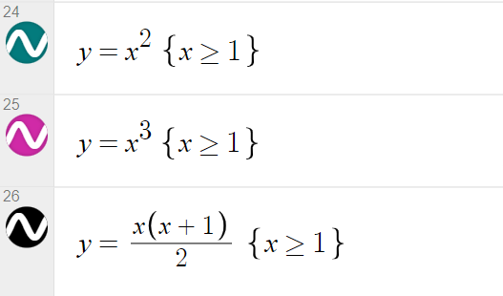
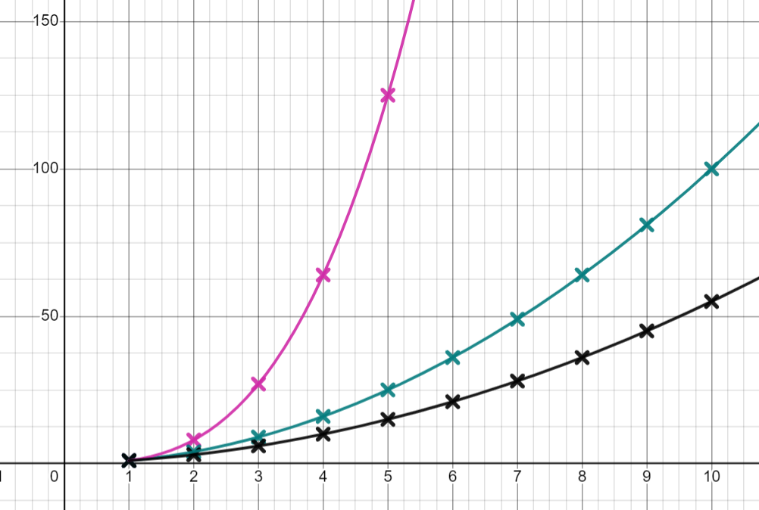
Exploring special number sequences
If you have not already done so, input the equations for the square, cube and triangular numbers when x is greater than or equal to 1 into Desmos.
Your graph should now look like this:

Slide 30
Exploring special number sequences
We are going to explore another type of sequence.
This sequence has the first two terms 1, 1, …
The next term is generated by adding the previous two together: 1, 1, 2, ..
What are the next three terms?
1, 1, 2, 3, 5, 8, …
Using the table function on Desmos, plot these six terms.

Slide 31
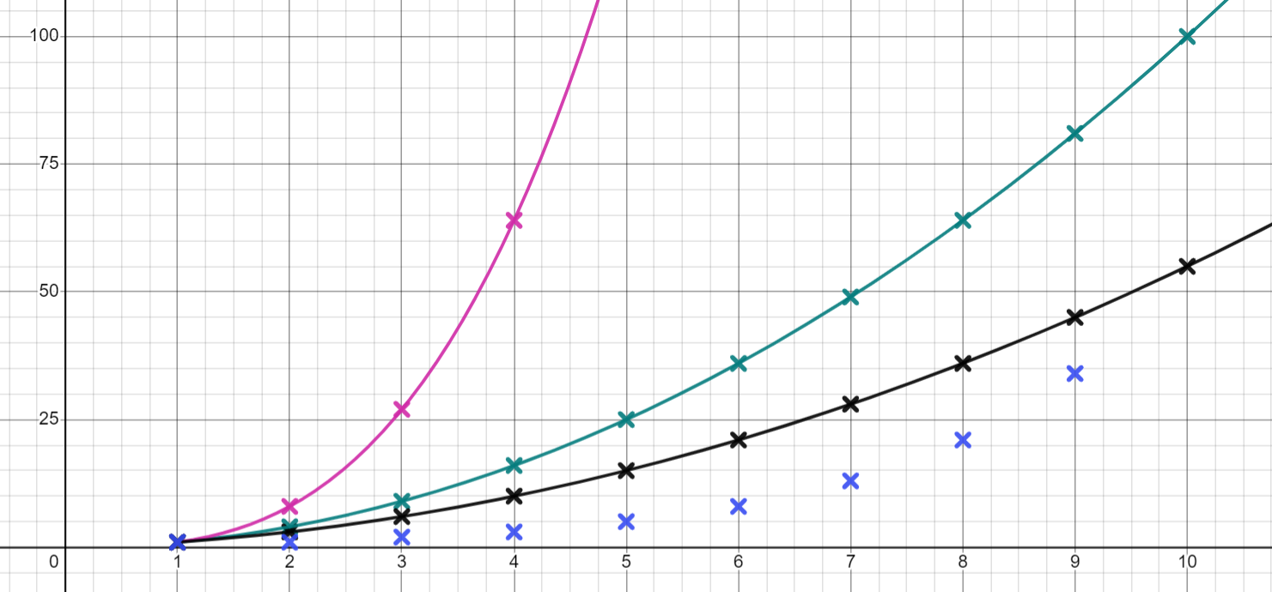
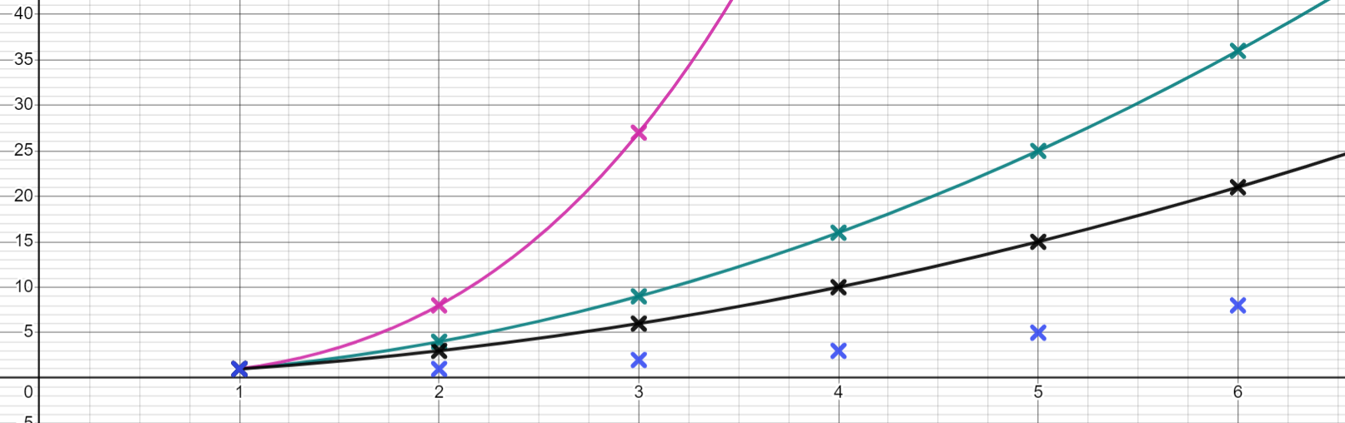
Exploring special number sequences
This sequence seems to be rising at the slowest rate.
Lucas
Oh, now I think it might overtake the triangular numbers.
Plot the next three terms to see what happens.
Plot the 10th term, what do you notice?
The 10th term in our sequence (55) is the same as the 10th triangular number.
When does our sequence overtake the square numbers?
The 12th term in our sequence (144) is the same as the 12th square number.

Slide 32
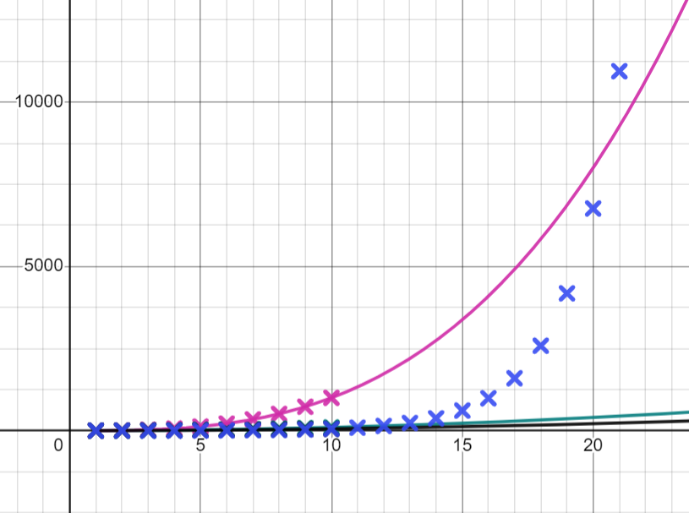
Exploring special number sequences
Surely this new sequence will never overtake the cube numbers, they increase at such a fast rate.
What do you think?
Fill in the table up to term 20 to see what happens.
Jacob
You may need to keep adjusting your scale to see the new points.
(Use a calculator to help with larger sums where necessary.)
Our sequence overtakes cube numbers between terms 20 and 21.

Slide 33
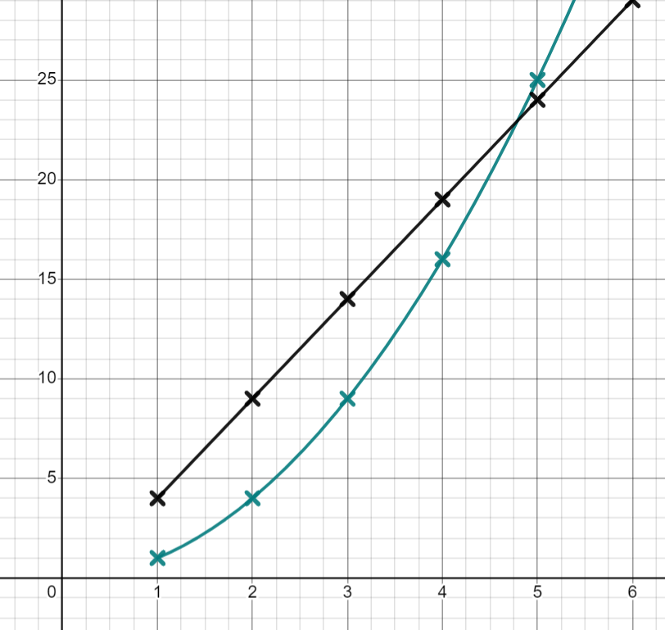

Exploring special number sequences
This graph shows the sequence of square numbers and the sequence
5n − 1. Which of these statements are true?
Both sequences contain the number 4
Both sequences contain the number 9
Both sequences contain the number 14
Both sequences have the same 5th term

Slide 34
Exploring special number sequences
1a) Plot the first 20 points of the sequences 2n, n² and 2^{n}
b) Two of the sequences have the same first term, which two?
c) What is happening at the coordinate (2,4) what does this mean about the sequences?
d) Which sequence is increasing at the fastest rate?
e) Find four numbers which are in the sequence 2n and 2^{n}
f) What is the 15th term in the sequence 2^{n}?

Slide 35
Exploring special number sequences
2a) Plot the first 20 points of the sequences 5 − n², 5 + n² and n³− 5
b) Which sequence has the smallest 1st term?
c) Which sequence has the smallest 2nd term?
d) Which sequence has the largest 3rd term?
e) What do you notice about the sequences 5 + n² and 5 − n²?

Slide 36
Exploring special number sequences
3a) The sequence of all triangular numbers has the n^{th} term rule plot the first 20 terms.
b) What is the 19th triangular number?
c) The geometric sequence which starts 1, 2, 4, 8,... has the n^{th} term rule 2^{n − 1} at what term number does this sequence overtake the triangular numbers?
e) Which is larger the 8th term in the sequence 2^{n − 1} or the 16th triangular number.

Slide 37
Exploring special number sequences
4a) A sequence starts 1, 3, 4, … the next term is found by adding the two previous terms together. Plot the first 10 terms of this sequence.
b) A different sequence starts 1, −3, … the next term is found by adding the two previous terms together. Plot the first 10 terms of this sequence.
c) How does the shape of the graph of this sequence differ to the previous one?

Slide 38
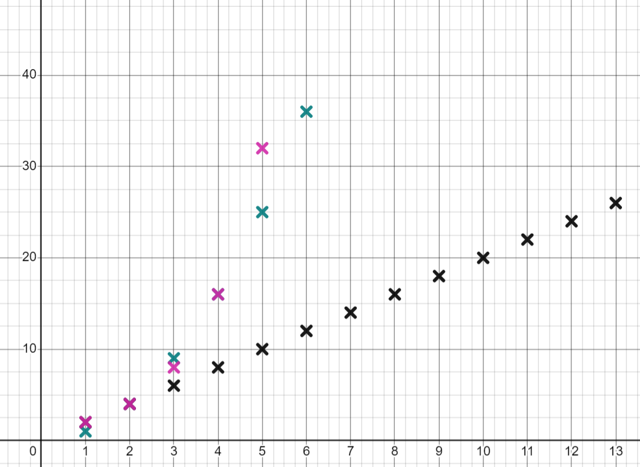
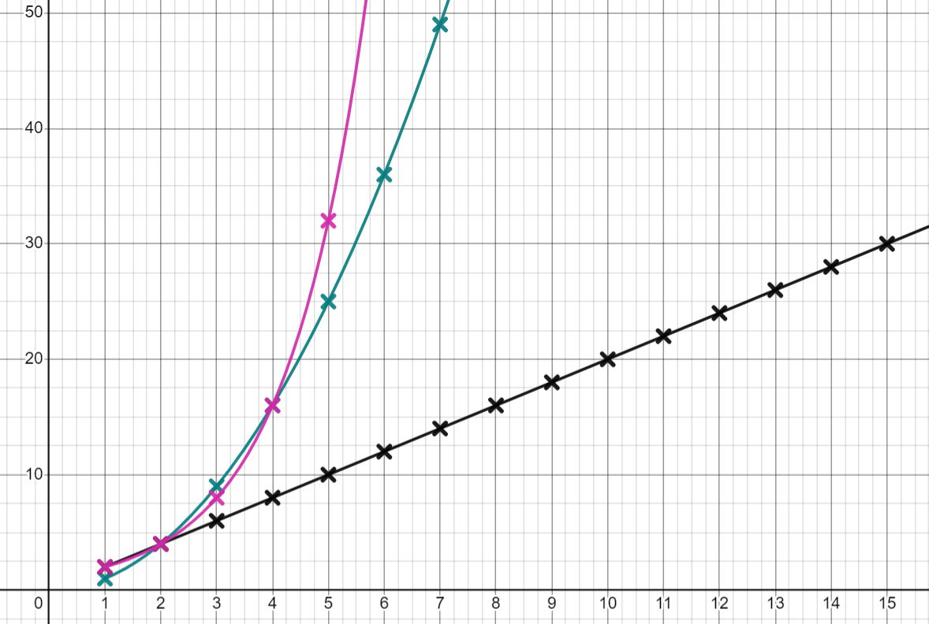
Exploring special number sequences
1a) Plot the first 20 points of the sequences 2n, n² and 2^{n}
Adding the curves in may help see key features of these sequences

Slide 39
Exploring special number sequences
1b) Two of the sequences have the same first term, which two?
2n and 2^{n}
c) What is happening at the coordinate (2,4) what does this mean about the sequences? All three sequences have a second term of 4
d) Which sequence is increasing at the fastest rate?
2^{n}
e) Find four numbers which are in the sequence 2n and 2^{n} all numbers in 2^{n} are also in 2n so 2, 4, 8, 16, 32, 64, 128,.....
f) What is the 15th term in the sequence 2^{n}? 32 768

Slide 40
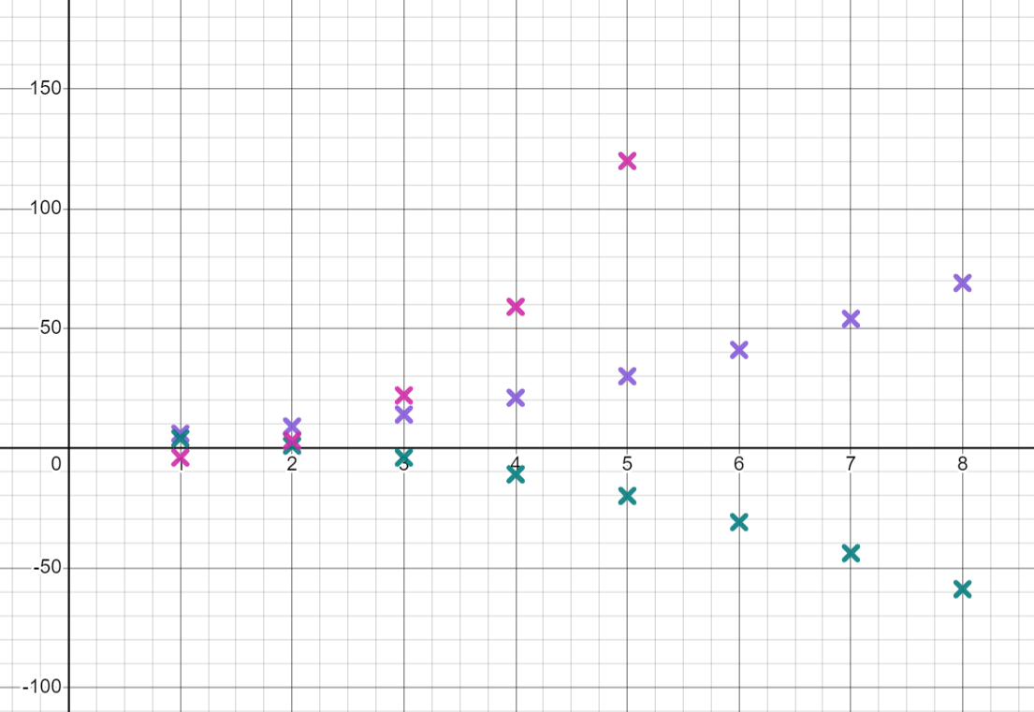
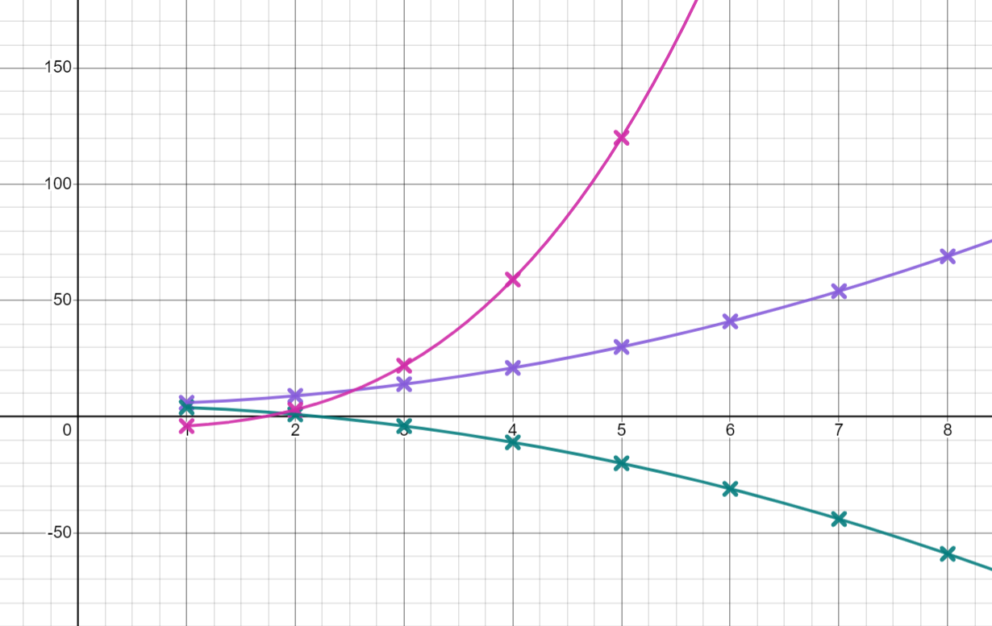
Exploring special number sequences
2a) Plot the first 20 points of the sequences 5 − n², 5 + n² and n³− 5
Adding the curves in may help see key features of these sequences

Slide 41
Exploring special number sequences
2b) Which sequence has the smallest 1st term?
n³− 5
c) Which sequence has the smallest 2nd term?
5 − n²
d) Which sequence has the largest 3rd term?
n³− 5
e) What do you notice about the sequences 5 + n² and 5 − n²?
You may have said: they are reflections of each other, the terms in 5 + n² are always larger than the terms in 5 − n²

Slide 42
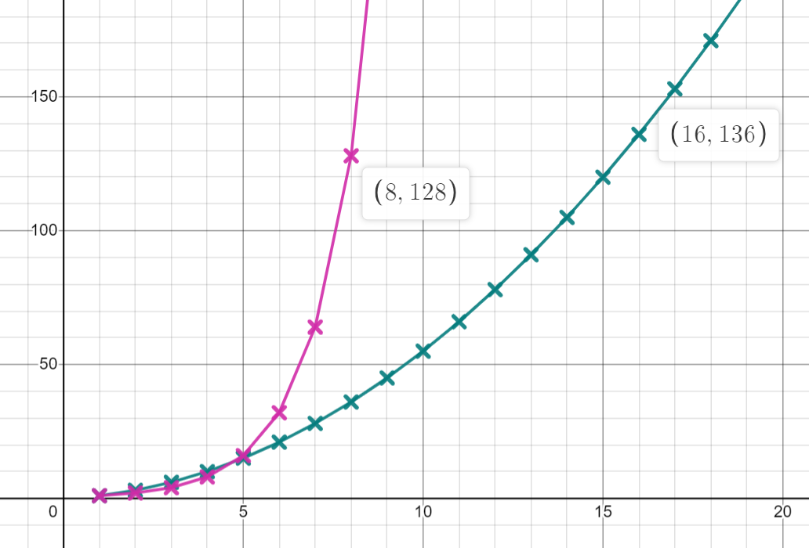
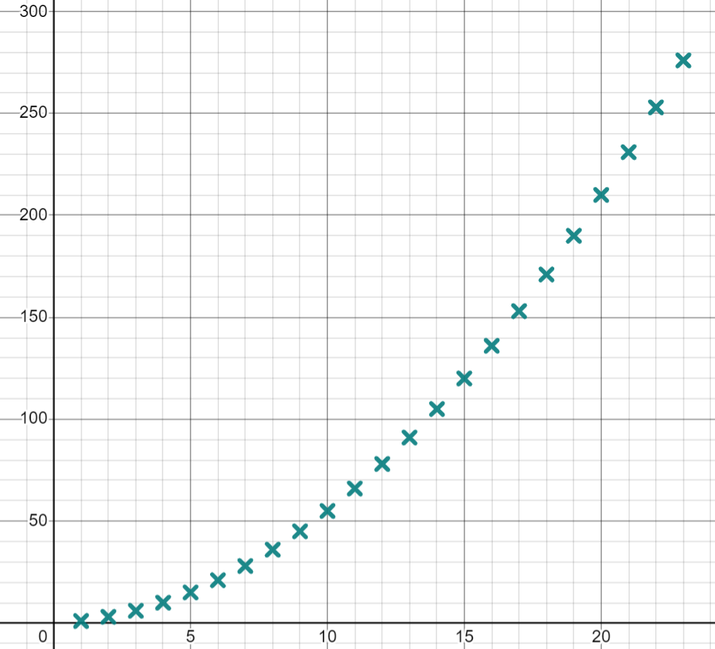
Exploring special number sequences
3a) The sequence of all triangular numbers has the n^{th} term rule plot the first 20 terms.
b) What is the 19th triangular number?
c) The geometric sequence which starts
1, 2, 4, 8,... has the n^{th} term rule 2^{n − 1} at what term number does this sequence overtake the triangular numbers?
e) Which is larger the 8th term in the sequence 2^{n − 1} or the 16th triangular number.
190
Term 5
The 16th triangular number (136 > 128)

Slide 43
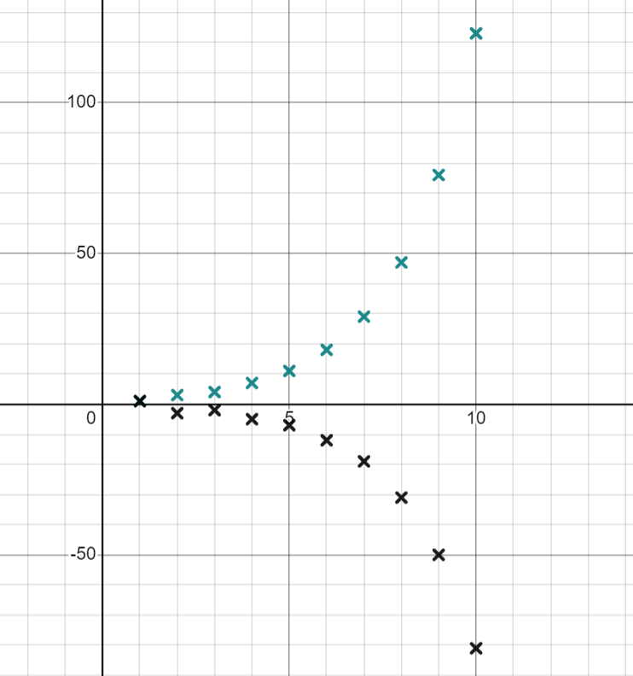
Exploring special number sequences
4a) A sequence starts 1, 3, 4, … the next term is found by adding the two previous terms together. Plot the first 10 terms of this sequence.
b) A different sequence starts 1, −3, … the next term is found by adding the two previous terms together. Plot the first 10 terms of this sequence.
c) How does the shape of the graph of this sequence differ to the previous one?
E.g. After the 3rd term the graph is decreasing. After the first few terms both graphs become curves, the second graph has a general curve shape like the previous one but with a noticeable ‘dip’ at term 2

Slide 44
Graphing special number sequences using technology
Sequences can be plotted on Desmos using the table function.
If the n^{th} term rule is known then points can be generated easily.
We can use graphing software to see if a term is in a sequence.
Special number sequences can be plotted if we can understand how they are generated. These can produce interesting graphs.

Slide 45

© Oak National Academy 2024.
Produced in partnership with Mathematics in Education and Industry.
Licensed on the Open Government Licence v3.0, except where otherwise stated. See Oak terms and conditions.

